Slide 1
LOAD BALANCER FOR ESMART

Slide 2
Agenda
Objectives
Background
Architecture
Load Balancer
Mysql Multi Master Replication
Testing
Q & A

Slide 3
Objectives
No Single Point of failure
can automatically detect and recover from a failed or offline computer.
automatically rebalance the network load when hosts are added or removed.

Slide 4
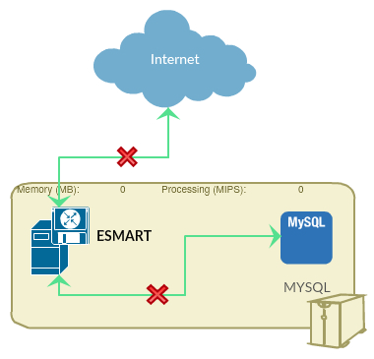
Background
No Load Balancing

Slide 5
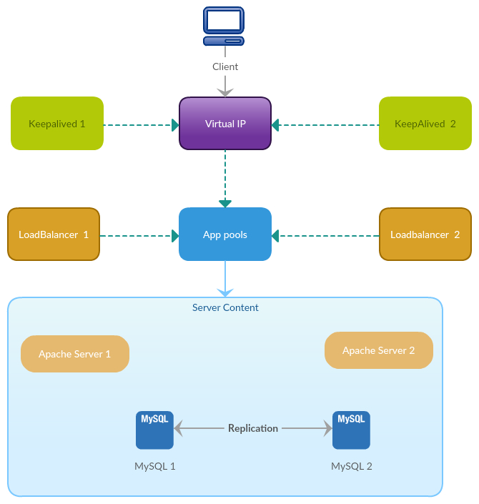
Architecture

Slide 6
Architecture

Slide 7
Load Balancing Types
DNS
Hardware
Software

Slide 8
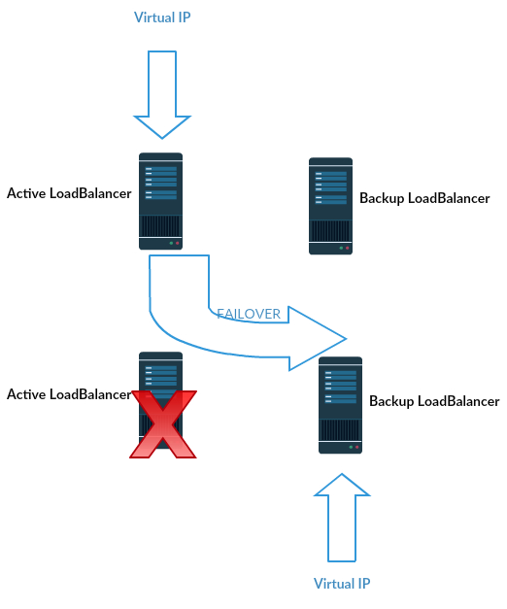
Software Loadbalancer

Slide 9
Keepalived
Open Source
Written in C++
setup the Virtual IP addresses (i.e., no need to create the Virtual IP's with ifconfig, etc)
handle failover between load balancers (i.e., no need to run heartbeat to watch for failures, or write scripts to handle the failure)
do health checks on services, bringing them in and out of pools (no need to run monitoring+custom scripts)

Slide 10
Keepalived Config
# Keepalived process identifier
lvs_id haproxy_DH
}
# Script used to check if HAProxy is running
vrrp_script check_haproxy {
script "killall -0 haproxy"
interval 2
weight 2
}
# Virtual interface
# The priority specifies the order in which the assigned interface to take over in a failover
vrrp_instance VI_01 {
state MASTER/SLAVE
interface eth0
virtual_router_id 51 -→ must be same on Both Master and Slave
priority 101 -→ numeric value is less than Mater server
# The virtual ip address shared between the two load balancers
virtual_ipaddress {
169.144.5.4 -→ Virtual IP Address
}
track_script {
check_haproxy
}
}

Slide 11
HAProxy
HAProxy is a fast, reliable and free implementation of load balancer proxy for TCP (layer 4) and HTTP (layer7) based applications
HAProxy is written by C programming language which makes it fast and efficient.
Some of well known websites with HAProxy are Stackoverflow, GitHub, Reddit, Tumblr and Twitter

Slide 12
HAPROXY Vs Other Solutions(NGINX)
HAPROXY | NGINX
Faster | Complicated, Slower
Open Source | Work with Windows
Admin Console | No Admin Console
TCP(Layer 4) and HTTP(Layer 7) | Only HTTP Layer 7

Slide 13
Implementation
Install HAProxy
Enable
Configure
Peering
Testing

Slide 14
Installation
Install and configure 2 HAProxy servers (Haproxy1/Haproxy2) that will direct traffic to 2 Apache web servers (Apache1/Apache2)
E.g.
Haproxy1- 169.144.5.161
Haproxy2-169.144.5.152
yum -y install haproxy (Red Hat Linux)
sudo apt-get install haproxy(ubuntu)

Slide 15
Haproxy Configurations
edit the HAProxy config file, /etc/haproxy/haproxy.cfg
vi etc/haproxy/haproxy.cfg
global section
default section
Load Balancing Configuration
frontend - where HAProxy listens to connections
backend - Where HAPoxy sends incoming connections
stats - Optionally, setup HAProxy web tool for monitoring the load balancer and its nodes

Slide 16
Frontend Configuration
Example:
frontend localnodes
mode http
bind 0.0.0.0:80
default backend nodes
bind *:80 - HAProxy will listen on port 80 on each available network for new HTTP connections
mode http - This is listening for HTTP connections.
default backend nodes - This frontend should use the backend named nodes, which we'll see next.

Slide 17
Backend Configuration
Example:
backend nodes
mode http
balance roundrobin
option httpclose
option forwardfor
cookie SERVERNAME insert indirect nocache
server lamp1 169.144.5.160:80 cookie s1 check
server lamp2 169.144.5.165:80 cookie s2 check
mode http - This will pass HTTP requests to the servers listed
balance roundrobin - Use the roundrobin strategy for distributing load amongst the servers
server lamp1 169.144.5.160:80 cookie s1 check-
Lamp1 – arbitrary name
169.144.5.160:80- Ip address and port of apache server
check- tell HAProxy to health check the server

Slide 18
Load Balancing Algorithm
Roundrobin- distribute traffic amongst our two servers according to their weights.
leastconn- server with the lowest number of connections receives the connection. This is better for servers with long-running connections (LDAP, SQL, TSE), but not necessarily for short-lived connections (HTTP).

Slide 19
Monitoring HAProxy
HAProxy comes with a web interface for monitoring the load balancer and the servers
Example:
listen stats 0.0.0.0:8089
mode http
stats enable
stats uri /stats
stats realm HAProxy\ Statistics
stats auth admin:admin
listen stats *:8089- Use the listen directive, name it stats and have it listen on port 8089.
stats enable - Enable the stats monitoring dashboard
stats uri / - The URI to reach it is just / (on port 8089)
stats hide-version - Hide the version of HAProxy used
stats auth someuser:password - Use HTTP basic authentication, with the set username and password.

Slide 20
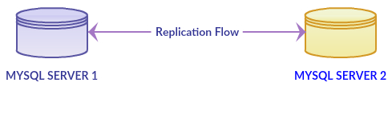
MYSQL Multi Master Replication

Slide 21
MYSQL Multi Master Configuration
-----Execute Command on Server 1------
mysql> show master status\G;
*************************** 1. row ***************************
File: mysql-bin.000001
Position: 401
Binlog_Do_DB:
Binlog_Ignore_DB:
Executed_Gtid_Set:
1 row in set (0.00 sec)
ERROR:
No query specified
-----Execute Command on Server 2-------
5. change master to
master_host='169.144.40.44',
master_user='ericsson',
master_password='ericsson',
master_log_file='mysql-bin.000001',
master_log_pos=401;

Slide 22
Testing
Backup LB02(SLB1): 169.144.4.203 (interface: eth0)
Active LB01(SLB2): 169.144.5.161 (interface: eth0)
Virtual IP: 169.144.5.4
LAMP1: 169.144.4.203
LAMP2: 169.144.5.161
Mysql1: 169.144.40.44
Mysql2: 169.144.4.203

Slide 23
Q& A..?

